Slide 1
PLASMA WELDING MACHINE AT ARCRAFT PLASMA

Slide 2
Plasma arc welding (PAW) is an advanced arc welding process based on Gas Tungsten Arc Welding (GTAW) process.
The electric arc is formed between an electrode (which is always made of tungsten) and the work-piece.
The key difference from GTAW is that in PAW by positioning the electrode within the body of the torch the plasma arc can be separated from the shielding gas envelope.
Actually all welding arcs are (partially ionized) plasmas but, the one in plasma arc welding is constricted arc plasma.
The constriction increases the temperature of the arc and also gives it the shape of a fine beam.
This enables welding at high speed, greater penetration, narrow HAZ (heat affected zone) and minimum heat input to the job.
ARCRAFT PLASMA

Slide 3
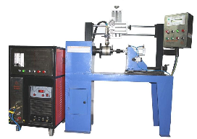

Slide 4
FEATURES
Less sensitivity to changes in Arc length.
Recessed electrode reduces the possibility of tungsten inclusions in the weld and can substantially increase the period between electrode dressings resulting in increased life.
Weld in a single pass up to 6 mm plates in square butt position and 10 mm plates in only two passes.
Keyhole mode of welding gives smaller heat affected zone resulting in reduced strength loss at the joint for heat treated metals, promotes less grain growth which gives better ductility.
Reduced weld time results in less embrittlement by carbides and complex inter metallic Compounds for stainless steel and super alloys.
Equalization of distortion stresses results in less residual stress.
Less filler metal required in keyhole mode significantly reduces porosity.
ARCRAFT PLASMA

Slide 5
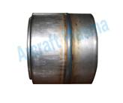
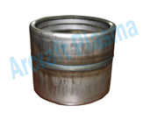
SAMPLES
ARCRAFT PLASMA

Slide 6
APPLICATIONS
Aerospace and Space Industries.
Cryogenics.
Foodstuff.
Chemical Industries.
Machine and Plant Construction.
Automobile, Railway, Ship Construction.
Tank, Equipment and Pipeline Construction etc
ARCRAFT PLASMA

Slide 7
SCOPE OF SUPPLY
Power Source
Plasma Welding Torch (400 Amp) with 4mtr Cable.
Earthing Clamp with 4mtr Cable.
Foot Switch with 4mtr Cable.
Water Chiller cum Re- circulator.
Consumable Package (3-Electrode, 3-Nozzle, 1-Ceramic Sleeve, 1-Ceramic Cap)
ARCRAFT PLASMA

Slide 8
THANK YOU ARCRAFT PLASMA EQUIPMENTS PVT. LTD. Address : 124, Diamond Industrial Estate, Ketkipada, Dahisar (East), Mumbai- 68. Ph : 0091-22-28965890/5745/3247. Fax: 00-91-22-28966418 . email : arcraftplasma@gmail.com Website : www.arcraftplasma.com

